Slide 1
Network Security I
Department of
York College of Pennsylvania

Slide 2
Chapter 5:
5.1 Network Security Concepts
5.2 The Link Layer
5.3 The Network Layer
5.4 The Transport layer
5.5 Denial of Service Attacks

Slide 3
Circuit and Packet Switching
• Circuit switching
– Legacy phone network
– Single route through sequence of hardware devices established when two nodes start communication
– Data sent along route
– Route maintained until communication ends
Packet switching
Internet Data split into packets
Packets transported independently through network
Each packet handled on a best efforts basis
Packets may follow different routes

Slide 4
Protocols
A protocol defines the rules for communication between computers
Protocols are broadly classified as connectionless and connection oriented
Connectionless protocol – Sends data out as soon as there is enough data to be transmitted – E.g., user datagram protocol (UDP)
Connection-oriented protocol
– Provides a reliable connection stream between two nodes
– Consists of set up, transmission, and tear down phases
– Creates virtual circuit-switched network
– E.g., transmission control protocol (TCP)
Notes:
Database: A collection of data and a set of rules that organize the data by specifying certain relationships among the data
Database administrator: Person who defines the rules that organize the data and controls who should have access to what parts of the data
Database management system: The system through which users interact with the database
Record: One related group of data
Field/element: Elementary data items that make up a record (e.g., name, address, city)
Schema: Logical structure of a database
Subschema: The portion of a database a given user has access to
Attribute: A column in a database
Relation: A set of database columns

Slide 5
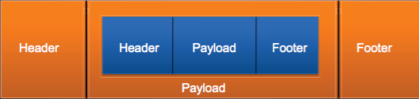
Encapsulation
A packet typically consists of
– Control information for addressing the packet: header and footer – Data: payload
• A network protocol N1 can use the services of another network protocol N2
– A packet p1 of N1 is encapsulated into a packet p2 of N2 – The payload of p2 is p1 – The control information of p2 is derived from that of p1

Slide 6
Network Layers
Network models typically use a stack of layers
– Higher layers use the services of lower layers via encapsulation
– A layer can be implemented in hardware or software
– The bottommost layer must be in hardware
A network device may implement several layers
A communication channel between two nodes is established for each layer
– Actual channel at the bottom layer – Virtual channel at higher layers
Notes:
The basic building block of a relational database is a table of data, consisting of rows
and columns, similar to a spreadsheet. Each column holds a particular type of data,
while each row contains a specific value for each column. Ideally, the table has at
least one column in which each value is unique, thus serving as an identifier for a
given entry. For example, a typical telephone directory contains one entry for each
subscriber, with columns for name, telephone number, and address. Such a table is
called a flat file because it is a single two-dimensional (rows and columns) file. In a
flat file, all of the data are stored in a single table. For the telephone directory, there
might be a number of subscribers with the same name, but the telephone numbers
should be unique, so that the telephone number serves as a unique identifier for a
row. However, two or more people sharing the same phone number might each be
listed in the directory. To continue to hold all of the data for the telephone directory
in a single table and to provide for a unique identifier for each row, we could require
a separate column for secondary subscriber, tertiary subscriber, and so on. The result
would be that for each telephone number in use, there is a single entry in the table.
The drawback of using a single table is that some of the column positions for
a given row may be blank (not used). Also, any time a new service or new type of
information is incorporated in the database, more columns must be added and the
database and accompanying software must be redesigned and rebuilt.
The relational database structure enables the creation of multiple tables
tied together by a unique identifier that is present in all tables.
Users and applications use a relational query language to access the database.
The query language uses declarative statements rather than the procedural
instructions of a programming language. In essence, the query language allows
the user to request selected items of data from all records that fit a given set of
criteria. The software then figures out how to extract the requested data from one
or more tables. For example, a telephone company representative could retrieve a
subscriber’s billing information as well as the status of special services or the latest
payment received, all displayed on one screen.

Slide 7
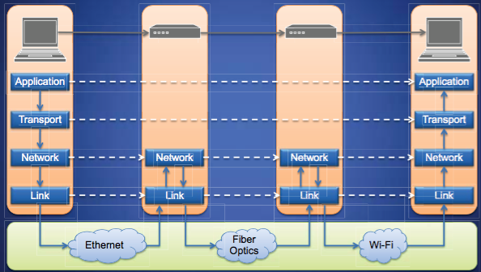
Internet Layers

Slide 8
Intermediate Layers
Link layer
– Local area network: Ethernet, WiFi, optical fiber
– 48-bit media access control (MAC) addresses – Packets called frames
Network layer
– Internet-wide communication – Best efforts – 32-bit internet protocol (IP) addresses in IPv4
– 128-bit addresses in IPv6
Transport layer
– 16-bit addresses (ports) for classes of applications – Connection-oriented transmission layer protocol (TCP)
– Connectionless user datagram protocol (UDP)
Notes:
Structured Query Language (SQL) is a standardized language that can be used to
define schema, manipulate, and query data in a relational database. There are several
versions of the ANSI/ISO standard and a variety of different implementations,
but all follow the same basic syntax and semantics.
SQL statements
can be used to create tables, insert and delete data in tables, create views, and
retrieve data with query statements.

Slide 9
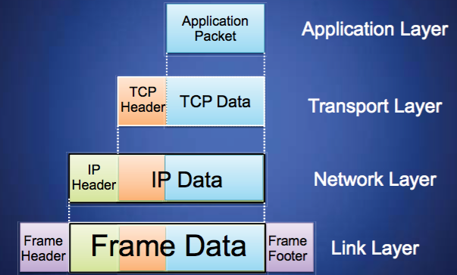
Internet Packet Encapsulation

Slide 10
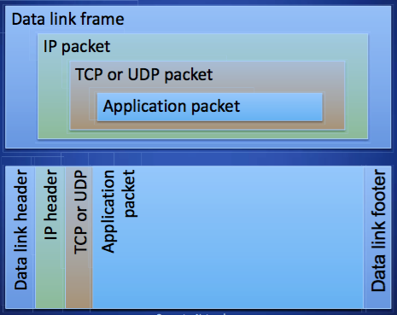
Internet Packet Encapsulation

Slide 11
Network Interfaces
Network interface: device connecting a computer to a network
– Ethernet card
– WiFi adapter
A computer may have multiple network interfaces
Packets transmitted between network interfaces
Most local area networks, (including Ethernet and WiFi)
broadcast frames
In regular mode, each network interface gets the frames
intended for it
Traffic sniffing can be accomplished by configuring the
network interface to read all frames (promiscuous mode)

Slide 12
Chapter 5: Roadmap
5.1 Network Security Concepts
5.2 The Link Layer
5.3 The Network Layer
5.4 The Transport layer
5.5 Denial of Service Attacks

Slide 13
MAC Addresses
Most network interfaces come with a predefined MAC address
A MAC address is a 48-bit number usually represented in hex
– E.g., 00-1A-92-D4-BF-86
The first three octets of any MAC address are IEEE-assigned Organizationally Unique Identifiers
– E.g., Cisco 00-1A-A1, D-Link 00-1B-11, ASUSTek 00-1A-92
The next three can be assigned by organizations as they please, with uniqueness being the only constraint
Organizations can utilize MAC addresses to identify computers on their network
MAC address can be reconfigured by network interface driver software

Slide 14
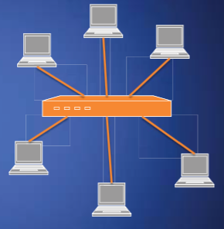
Switch
Switch
– Operates at the link layer
– Has multiple ports, each connected to a computer
• Operation of a switch
– Learn the MAC address of each computer connected to it
– Forward frames only to the destination computer

Slide 15
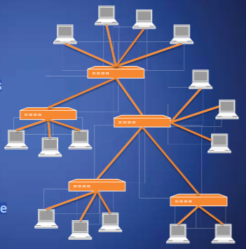
Combining Switches
Switches can be arranged into a tree
Each port learns the MAC addresses of the machines in the segment (subtree) connected to it
Fragments to unknown MAC addresses are broadcast
Frames to MAC addresses in the same segment as the sender are ignored
Notes:
This is a good time to encourage students to think about places databases are commonly used and all the purposes they may be used for. Examples such as banks, large retailers, and law enforcement quickly make clear why all of these requirements are critically important. We’ve already discussed many of the ways these requirements are achieved in previous chapters, but the remainder of this chapter covers special considerations for databases.

Slide 16
MAC Address Filtering
A switch can be configured to provide service only to machines with specific MAC addresses
Allowed MAC addresses need to be registered with a network administrator
A MAC spoofing attack impersonates another machine
– Find out MAC address of target machine – Reconfigure MAC address of rogue machine – Turn off or unplug target machine
Countermeasures
– Block port of switch when machine is turned off or unplugged – Disable duplicate MAC addresses

Slide 17
Viewing and Changing MAC Addresses
Viewing the MAC addresses of the interfaces of a machine
– Linux: ifconfig
– Windows: ipconfig/all
Changing a MAC address in Linux
– Stop the networking service:/etc/init.d/network stop – Change the MAC address: ifconfig eth0 hw ether <MAC-address> – Start the networking service: /etc/init.d/network start
Changing a MAC address in Windows
– Open the Network Connections applet – Access the properties for the network interface – Click “Configure...” – In the advanced tab, change the network address to the desired value
Changing a MAC address requires administrator privileges
Notes:
Commercial and open-source DBMSs typically provide an access control capability
for the database. The DBMS operates on the assumption that the computer system
has authenticated each user. As an additional line of defense, the computer system
may use the overall access control system described in Chapter 4 to determine
whether a user may have access to the database as a whole. For users who are
authenticated and granted access to the database, a database access control system
provides a specific capability that controls access to portions of the database.
Commercial and open-source DBMSs provide discretionary or role-based
access control. We defer a discussion of mandatory access control considerations
to Chapter 13 . Typically, a DBMS can support a range of administrative policies,
including the following:
• Centralized administration: A small number of privileged users may grant and
revoke access rights.
• Ownership-based administration: The owner (creator) of a table may grant
and revoke access rights to the table.
• Decentralized administration: In addition to granting and revoking access rights
to a table, the owner of the table may grant and revoke authorization rights to
other users, allowing them to grant and revoke access rights to the table.
As with any access control system, a database access control system distinguishes
different access rights, including create, insert, delete, update, read, and write. Some
DBMSs provide considerable control over the granularity of access rights. Access
rights can be to the entire database, to individual tables, or to selected rows or columns
within a table. Access rights can be determined based on the contents of a table entry.
For example, in a personnel database, some users may be limited to seeing salary
information only up to a certain maximum value. And a department manager may
only be allowed to view salary information for employees in his or her department.

Slide 18
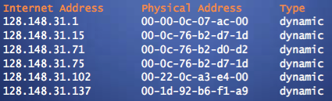
ARP
The address resolution protocol (ARP) connects the network layer to the data layer by converting IP addresses to MAC addresses
ARP works by broadcasting requests and caching responses for future use
The protocol begins with a computer broadcasting a message of the form
who has <IP address1> tell <IP address2>
When the machine with <IP address1> or an ARP server receives this
message, its broadcasts the response
<IP address1> is <MAC address>
The requestor’s IP address <IP address2> is contained in the link header
The Linux and Windows command arp - a displays the ARP table
Notes:
SQL provides two commands for managing access rights, GRANT and REVOKE.
For different versions of SQL, the syntax is slightly different. In general terms, the
GRANT command has the following syntax:
GRANT { privileges | role }
[ON table]
TO { user | role | PUBLIC }
[IDENTIFIED BY password]
[WITH GRANT OPTION]
This command can be used to grant one or more access rights or can be used
to assign a user to a role. For access rights, the command can optionally specify that
it applies only to a specified table. The TO clause specifies the user or role to which
the rights are granted. A PUBLIC value indicates that any user has the specified
access rights. The optional IDENTIFIED BY clause specifies a password that
must be used to revoke the access rights of this GRANT command. The GRANT
OPTION indicates that the grantee can grant this access right to other users, with or
without the grant option.
As a simple example, consider the following statement.
GRANT SELECT ON ANY TABLE TO ricflair
This statement enables user ricflair to query any table in the database.
Different implementations of SQL provide different ranges of access rights.
The following is a typical list:
• Select: Grantee may read entire database; individual tables; or specific
columns in a table.
• Insert: Grantee may insert rows in a table; or insert rows with values for specific
columns in a table.
• Update: Semantics is similar to INSERT.
• Delete: Grantee may delete rows from a table.
• References: Grantee is allowed to define foreign keys in another table that
refer to the specified columns.
The REVOKE command has the following syntax:
REVOKE { privileges | role }
[ON table]
FROM { user | role | PUBLIC }
Thus, the following statement revokes the access rights of the preceding example:
REVOKE SELECT ON ANY TABLE FROM ricflair

Slide 19
ARP Spoofing
The ARP table is updated whenever an ARP response is received
Requests are not tracked
ARP announcements are not authenticated
Machines trust each other
A rogue machine can spoof other machines

Slide 20
ARP Poisoning (ARP Spoofing)
According to the standard, almost all ARP implementations are stateless
An arp cache updates every time that it receives an arp reply... even if it did not send any arp request!
It is possible to “poison” an arp cache by sending gratuitous arp replies
• Using static entries solves the problem but it is almost impossible to manage!

Slide 21
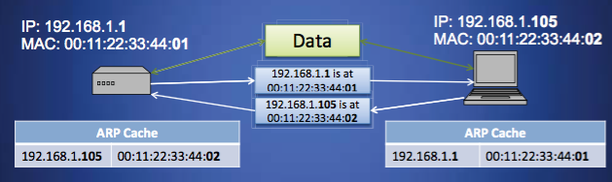
ARP Caches

Slide 22
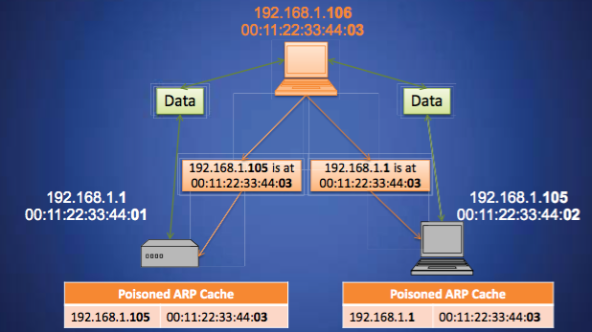
Poisoned ARP Caches

Slide 23
Chapter 5: Roadmap
5.1 Network Security Concepts
5.2 The Link Layer
5.3 The Network Layer
5.4 The Transport layer
5.5 Denial of Service Attacks

Slide 24
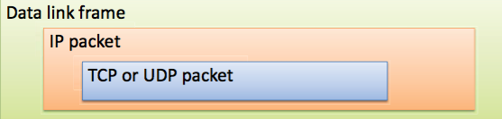
Internet Protocol
Connectionless
– Each packet is transported
independently from other packets
Unreliable
– Delivery on a best effort basis
– No acknowledgments
- Packets may be corrupted, or duplicated IP packets
– Encapsulate TCP and UDP packets
– Encapsulated into link-layer frames

Slide 25
IP Routing
A router bridges two or more networks
– Operates at the network layer
– Maintains tables to forward packets to the appropriate network
– Forwarding decisions based solely on the destination address
Routing table
– Maps ranges of addresses to LANs or other gateway routers

Slide 26
Internet Routes
Internet Control Message Protocol (ICMP)
– Used for network testing and debugging – Simple messages encapsulated in single IP packets
– Considered a network layer protocol
Tools based on ICMP
– Ping: sends series of echo request messages and provides statistics on roundtrip times and packet loss
– Traceroute: sends series ICMP packets with increasing TTL value to discover routes

Slide 27
IP Spoofing
IP Spoofing is an attempt by an intruder to send packets from one IP address that appear to originate at another
If the server thinks it is receiving messages from the real source after authenticating a session, it could inadvertently behave maliciously
There are two basic forms of IP Spoofing
Blind Spoofing
– Attack from any source
Non-Blind Spoofing
– Attack from the same subnet

Slide 28
Blind IP Spoofing
The TCP/IP protocol requires that “acknowledgement” numbers be sent across sessions
Makes sure that the client is getting the server’s packets and vice versa
Need to have the right sequence of acknowledgment numbers to spoof an IP identity

Slide 29
Non-Blind IP Spoofing
IP Spoofing without inherently knowing the acknowledgment sequence pattern
– Done on the same subnet – Use a packet sniffer to analyze the sequence pattern
Packet sniffers intercept network packets
Eventually decodes and analyzes the packets sent across the network
Determine the acknowledgment sequence pattern from the packets
Send messages to server with actual client's IP address and with validly sequenced acknowledgment number

Slide 30
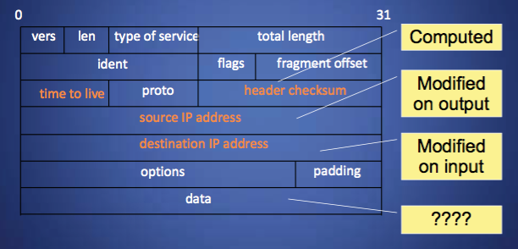
IP Packet Modifications

Slide 31
Packet Sniffers
Packet sniffers “read” information traversing a network
– Packet sniffers intercept network packets, possibly using ARP cache poisoning
– Can be used as legitimate tools to analyze a network
Monitor network usage
Filter network traffic
Analyze network problems
– Can also be used maliciously
Steal information (i.e. passwords, conversations, etc.)
Analyze network information to prepare an attack
Packet sniffers can be either software or hardware based
– Sniffers are dependent on network setup

Slide 32
Detecting Sniffers
Sniffers are almost always passive
– They simply collect data – They do not attempt “entry” to “steal” data
This can make them extremely hard to detect
Most detection methods require suspicion that sniffing is occurring
– Then some sort of “ping” of the sniffer is necessary
– It should be a broadcast that will cause a response only from a sniffer
Another solution on switched hubs is ARP watch
– An ARP watch monitors the ARP cache for duplicate entries of a machine
– If such duplicates appear, raise an alarm
– Problem: false alarms
• Specifically, DHCP networks can have multiple entires for a single machine

Slide 33
Stopping Packet Sniffing
The best way is to encrypt packets securely
– Sniffers can capture the packets, but they are meaningless
Capturing a packet is useless if it just reads as garbage
– SSH is also a much more secure method of connection
Private/Public key pairs makes sniffing virtually useless
– On switched networks, almost all attacks will be via ARP spoofing
• Add machines to a permanent store in the cache • This store cannot be modified via a broadcast reply
• Thus, a sniffer cannot redirect an address to itself
The best security is to not let them in in the first place
– Sniffers need to be on your subnet in a switched hub in the first place
– All sniffers need to somehow access root at some point to start themselves up

Slide 34
Chapter 5: Roadmap
5.1 Network Security Concepts
5.2 The Link Layer
5.3 The Network Layer
5.4 The Transport layer
5.5 Denial of Service Attacks

Slide 35
Network Address Translation
Introduced in the early 90s to alleviate IPv4 address space congestion
Relies on translating addresses in an internal network, to an external address that is used for communication to and from the outside world
NAT is usually implemented by placing a router in between the internal private network and the public network.
Saves IP address space since not every terminal needs a globally unique IP address, only an organizationally unique one
While NAT should really be transparent to all high level services, this is sadly not true because a lot of high level communication uses things on IP

Slide 36
Network Address Translation (NAT)
Notes:
With NAT, the source firewall converts the source address in the packet into the firewall’s own address. The firewall also makes an entry in a translation table showing the destination address, the source port, and the original source address to be able to forward any replies to the original source address. The firewall then converts the address back on any return packets. This has the effect of concealing the true address of the internal host and prevents the internal host from being reached directly.

Slide 37
Data Loss Prevention (DLP)
DLP is a set of technologies that can detect and possibly prevent attempts to send sensitive data where it is not allowed to go
Can be implemented as
Agent installed as an OS rootkit
Guard
Indicators DLP looks for:
Keywords
Traffic patterns
Encoding/encryption
DLP is best for preventing accidental incidents, as malicious users will often find ways to circumvent it

Slide 38
Session Hijacking
Also commonly known as TCP Session Hijacking
A security attack over a protected network
Attempt to take control of a network session
Sessions are server keeping state of a client’s connection
Servers need to keep track of messages sent between client and the server and their respective actions
Most networks follow the TCP/IP protocol
IP Spoofing is one type of hijacking on large network
Notes:
Solution to the concern that the database system would fail in the middle of an update, leaving the database in a partially updated and inconsistent state.

Slide 39
Port Knocking
Broadly port knocking is the act of attempting to make connections to blocked ports in a certain order in an attempt to open a port
Port knocking is fairly secure against brute force attacks since there are 65536k combinations, where k is the number of ports knocked
Port knocking however if very susceptible to replay attacks. Someone can theoretically record port knocking attempts and repeat those to get the same open port again
One good way of protecting against replay attacks would be a time dependent knock sequence.

Slide 40
IP Vulnerabilities
• Unencrypted transmission
– Eavesdropping possible at any intermediate host during routing
• No source authentication
– Sender can spoof source address, making it difficult to trace packet back to attacker
No integrity checking
– Entire packet, header and payload, can be modified while en route to destination, enabling content forgeries, redirections, and man-in-the-middle attacks
• No bandwidth constraints
- Large number of packets can be injected into network to launch a denial-of- service attack
- Broadcast addresses provide additional leverage

Slide 41
Chapter 5: Roadmap
5.1 Network Security Concepts
5.2 The Link Layer
5.3 The Network Layer
5.4 The Transport layer
5.5 Denial of Service Attacks

Slide 42
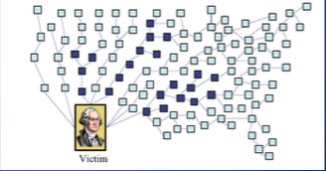
Denial of Service Attack
Send large number of packets to host providing service
– Slows down or crashes host
– Often executed by botnet
Attack propagation
– Starts at zombies
– Travels through tree of internet
routers rooted
– Ends at victim
IP source spoofing
Hides attacker
Scatters return traffic from victim

Slide 43
Flooding Attacks
Classified based on network protocol used
Intent is to overload the network capacity on some link to a server
Virtually any type of network packet can be used
ICMP flood
Ping flood using ICMP echo request packets
Traditionally network administrators allow such packets into their networks because ping is a useful network diagnostic tool
UDP flood
Uses UDP packets directed to some port number on the target system
TCP SYN flood
Sends TCP packets to the target system
Total volume of packets is the aim of the attack rather than the system code
Notes:
Flooding attacks take a variety of forms, based on which network protocol is being
used to implement the attack. In all cases the intent is generally to overload the
network capacity on some link to a server. The attack may alternatively aim to
overload the server’s ability to handle and respond to this traffic. These attacks flood
the network link to the server with a torrent of malicious packets competing with, and
usually overwhelming, valid traffic flowing to the server. In response to the congestion
this causes in some routers on the path to the targeted server, many packets will be
dropped. Valid traffic has a low probability of surviving discard caused by this flood
and hence of accessing the server. This results in the server’s ability to respond to
network connection requests being either severely degraded or failing entirely.
Virtually any type of network packet can be used in a flooding attack. It simply
needs to be of a type that is permitted to flow over the links toward the targeted system,
so that it can consume all available capacity on some link to the target server. Indeed,
the larger the packet, the more effective is the attack. Common flooding attacks use
any of the ICMP, UDP, or TCP SYN packet types. It is even possible to flood with
some other IP packet type. However, as these are less common and their usage more
targeted, it is easier to filter for them and hence hinder or block such attacks.
The ping flood using ICMP echo request packets we discuss in Section 7.1 is a classic
example of an ICMP flooding attack. This type of ICMP packet was chosen since
traditionally network administrators allowed such packets into their networks, as
ping is a useful network diagnostic tool. More recently, many organizations have
restricted the ability of these packets to pass through their firewalls. In response,
attackers have started using other ICMP packet types. Since some of these should
be handled to allow the correct operation of TCP/IP, they are much more likely to
be allowed through an organization’s firewall. Filtering some of these critical ICMP
packet types would degrade or break normal TCP/IP network behavior. ICMP
destination unreachable and time exceeded packets are examples of such critical
packet types.
An attacker can generate large volumes of one of these packet types. Because
these packets include part of some notional erroneous packet that supposedly
caused the error being reported, they can be made comparatively large, increasing
their effectiveness in flooding the link.
An alternative to using ICMP packets is to use UDP packets directed to some port
number, and hence potential service, on the target system. A common choice was a
packet directed at the diagnostic echo service, commonly enabled on many server
systems by default. If the server had this service running, it would respond with a
UDP packet back to the claimed source containing the original packet data contents.
If the service is not running, then the packet is discarded, and possibly an
ICMP destination unreachable packet is returned to the sender. By then the attack
has already achieved its goal of occupying capacity on the link to the server. Just
about any UDP port number can be used for this end. Any packets generated in
response only serve to increase the load on the server and its network links.
Spoofed source addresses are normally used if the attack is generated using
a single source system, for the same reasons as with ICMP attacks. If multiple systems
are used for the attack, often the real addresses of the compromised, zombie,
systems are used. When multiple systems are used, the consequences of both the
reflected flow of packets and the ability to identify the attacker are reduced.
Another alternative is to send TCP packets to the target system. Most likely these
would be normal TCP connection requests, with either real or spoofed source
addresses. They would have an effect similar to the SYN spoofing attack we’ve
described. In this case, though, it is the total volume of packets that is the aim of the
attack rather than the system code. This is the difference between a SYN spoofing
attack and a SYN flooding attack.
This attack could also use TCP data packets, which would be rejected by the
server as not belonging to any known connection. But again, by this time the attack
has already succeeded in flooding the links to the server.
All of these flooding attack variants are limited in the total volume of traffic
that can be generated if just a single system is used to launch the attack. The use
of a single system also means the attacker is easier to trace. For these reasons, a
variety of more sophisticated attacks, involving multiple attacking systems, have
been developed. By using multiple systems, the attacker can significantly scale up
the volume of traffic that can be generated. Each of these systems need not be particularly
powerful or on a high-capacity link. But what they don’t have individually,
they more than compensate for in large numbers. Also, by directing the attack
through intermediaries, the attacker is further distanced from the target and significantly
harder to locate and identify. Indirect attack types that utilize multiple
systems include
• Distributed denial-of-service attacks
• Reflector attacks
• Amplifier attacks
We consider each of these in turn.

Slide 44
ICMP Attacks
• Ping of death
– ICMP specifies messages must fit a single IP packet (64KB)
– Send a ping packet that exceeds maximum size using IP fragmentation
– Reassembled packet caused several operating systems to crash due to a buffer overflow
• Smurf
– Ping a broadcast address using a spoofed source address

Slide 45
DoS Attack: Smurf Attack

Slide 46
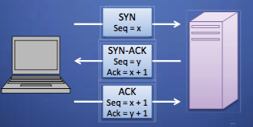
Establishing TCP Connections
TCP connections are established through a three way handshake.
The server generally has a passive listener, waiting for a connection request
The client requests a connection by sending out a SYN packet
The server responds by sending a SYN/ACK packet, indicating an
acknowledgment for the connection
The client responds by sending an ACK to the server thus establishing connection

Slide 47
TCP Data Transfer
During connection initialization using the three way handshake, initial sequence numbers are exchanged
The TCP header includes a 16 bit checksum of the data and parts of the header, including the source and destination
Acknowledgment or lack thereof is used by TCP to keep track of network congestion and control flow and such
TCP connections are cleanly terminated with a 4-way handshake
– The client which wishes to terminate the connection sends a FIN
message to the other client
– The other client responds by sending an ACK
– The other client sends a FIN
– The original client now sends an ACK, and the connection is terminated

Slide 48
SYN Flood
Typically DOS attack, though can be combined with other attack such as TCP hijacking
Rely on sending TCP connection requests faster than the server can process them
Attacker creates a large number of packets with spoofed source addresses and setting the SYN flag on these
The server responds with a SYN/ACK for which it never gets a response (waits for about 3 minutes each)
Eventually the server stops accepting connection requests, thus triggering a denial of service.
Can be solved in multiple ways
One of the common way to do this is to use SYN cookies

Slide 49
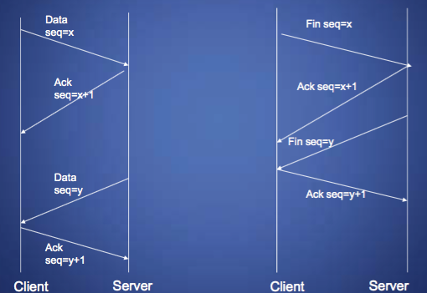
TCP Data Transfer and Teardown

Slide 50
TCP Congestion Control
During the mid-80s it was discovered that uncontrolled TCP messages were causing large scale network congestion
TCP responded to congestion by retransmitting lost packets, thus making the problem was worse
What is predominantly used today is a system where ACKs are used to determine the maximum number of packets which should be sent out
Most TCP congestion avoidance algorithms, avoid congestion by modifying a congestion window (cwnd) as more cumulative ACKs are received
Lost packets are taken to be a sign of network congestion
TCP begins with an extremely low cwnd and rapidly increases the
value of this variable to reach bottleneck capacity
At this point it shifts to a collision detection algorithm which slowly probes the network for additional bandwidth
TCP congestion control is a good idea in general but allows for certain attacks.

Slide 51
Optimistic ACK Attack
An optimistic ACK attack takes advantage of the TCP congestion control
It begins with a client sending out ACKs for data segments it hasn’t yet received
This flood of optimistic ACKs makes the servers TCP stack believe that there is a large amount of bandwidth available and thus increase cwnd
This leads to the attacker providing more optimistic ACKs, and eventually bandwidth use beyond what the server has available
This can also be played out across multiple servers, with enough congestion that a certain section of the network is no longer reachable
There are no practical solutions to this problem

Slide 52
Distributed Denial of Service DDoS Attacks
Use of multiple systems to generate attacks
Attacker uses a flaw in operating system or in a common application to gain access and installs their program on it (zombie)
Large collections of such systems under the control of one attacker’s control can be created, forming a botnet
Notes:
Recognizing the limitations of flooding attacks generated by a single system, one
of the earlier significant developments in DoS attack tools was the use of multiple
systems to generate attacks. These systems were typically compromised user workstations
or PCs. The attacker used some well-known flaw in the operating system or
in some common application to gain access to these systems and to install his or her
own programs on it. Such systems are known as zombies. Once suitable backdoor
programs were installed on these systems, they were entirely under the attacker’s
control. Large collections of such systems under the control of one attacker can be
created, collectively forming a botnet, as we discuss in Chapter 6 . Such networks of
compromised systems are a favorite tool of attacker, and can be used for a variety
of purposes, including distributed denial-of-service (DDoS) attacks. In the example
network shown in Figure 7.1 , some of the broadband user systems may be compromised
and used as zombies to attack any of the company or other links shown.
Many other DDoS tools have been developed since. Instead of using dedicated
handler programs, many now use an IRC or similar instant messaging server
program to manage communications with the agents. Many of these more recent
tools also use cryptographic mechanisms to authenticate the agents to the handlers,
in order to hinder analysis of command traffic.
The best defense against being an unwitting participant in a DDoS attack is to
prevent your systems from being compromised. This requires good system security
practices and keeping the operating systems and applications on such systems current
and patched.
For the target of a DDoS attack, the response is the same as for any flooding
attack, but with greater volume and complexity. We discuss appropriate defenses
and responses in Sections 7.5 and 7.6 .

Slide 53
Distributed Denial of Service (DDoS)
Notes:
Conscript an army of compromised machines to attack a victim.
Choose a victim, and have the whole army unleash a DoS attack at once.
DDoS attacks are much more effective than traditional DoS attacks, employing a multiplied version of the same methods.

Slide 54
IP Traceback
Problem
– How to identify leaves of DoS propagation tree
– Routers next to attacker
Issues
– There are more than 2M internet routers
– Attacker can spoof source address
- Attacker knows that traceback is being performed
Approaches
– Filtering and tracing (immediate reaction)
– Messaging (additional traffic)
- logging (additional storage)
- Probabilistic marking

Slide 55
Probabilistic Packet Marking
Method
– Random injection of information into packet header
– Changes seldom used bits – Forward routing information to victim – Redundancy to survive packet losses
Benefits
– No additional traffic – No router storage – No packet size increase – Can be performed online or offline

Slide 56
DoS Attack Defenses
These attacks cannot be prevented entirely
High traffic volumes may be legitimate
High publicity about a specific site
Activity on a very popular site
Described as slashdotted, flash crowd, or flash event
Four lines of defense against DDoS attacks
Attack prevention and preemption
Before attack
Attack detection and filtering
During the attack
Attack source traceback and identification
During and after the attack
Attack reaction
After the attack
Notes:
There are a number of steps that can be taken both to limit the consequences of
being the target of a DoS attack and to limit the chance of your systems being compromised
and then used to launch DoS attacks. It is important to recognize that
these attacks cannot be prevented entirely. In particular, if an attacker can direct a
large enough volume of legitimate traffic to your system, then there is a high chance
this will overwhelm your system’s network connection, and thus limit legitimate
traffic requests from other users. Indeed, this sometimes occurs by accident as a
result of high publicity about a specific site. Classically, a posting to the well-known
Slashdot news aggregation site often results in overload of the referenced server
system. Similarly, when popular sporting events like the Olympics or Soccer World
Cup matches occur, sites reporting on them experience very high traffic levels. This
has led to the terms slashdotted , flash crowd , or flash event being used to describe
such occurrences. There is very little that can be done to prevent this type of either
accidental or deliberate overload without also compromising network performance.
The provision of significant excess network bandwidth and replicated distributed
servers is the usual response, particularly when the overload is anticipated. This is
regularly done for popular sporting sites. However, this response does have a significant
implementation cost.
In general, there are four lines of defense against DDoS attacks [PENG07,
CHAN02]:
• Attack prevention and preemption (before the attack): These mechanisms
enable the victim to endure attack attempts without denying service to legitimate
clients. Techniques include enforcing policies for resource consumption
and providing backup resources available on demand. In addition, prevention
mechanisms modify systems and protocols on the Internet to reduce the
possibility of DDoS attacks.
• Attack detection and filtering (during the attack): These mechanisms attempt
to detect the attack as it begins and respond immediately. This minimizes the
impact of the attack on the target. Detection involves looking for suspicious
patterns of behavior. Response involves filtering out packets likely to be part
of the attack.
• Attack source traceback and identification (during and after the attack): This
is an attempt to identify the source of the attack as a first step in preventing
future attacks. However, this method typically does not yield results fast
enough, if at all, to mitigate an ongoing attack.
• Attack reaction (after the attack): This is an attempt to eliminate or curtail the
effects of an attack.
We discuss the first of these lines of defense in this section and consider the
remaining three in Section 7.7 .

Slide 57
DoS Attack Prevention
Block spoofed source addresses
On routers as close to source as possible
Filters may be used to ensure path back to the claimed source address is the one being used by the current packet
Filters must be applied to traffic before it leaves the ISP’s network or at the point of entry to their network
Use modified TCP connection handling code
Cryptographically encode critical information in a cookie that is sent as the server’s initial sequence number
Legitimate client responds with an ACK packet containing the incremented sequence number cookie
Drop an entry for an incomplete connection from the TCP connections table when it overflows
Notes:
A critical component of many DoS attacks is the use of spoofed source
addresses. These either obscure the originating system of direct and distributed DoS
attacks or are used to direct reflected or amplified traffic to the target system. Hence
one of the fundamental, and longest standing, recommendations for defense against
these attacks is to limit the ability of systems to send packets with spoofed source
addresses. RFC 2827, Network Ingress Filtering: Defeating Denial-of-service attacks
which employ IP Source Address Spoofing , directly makes this recommendation, as
do SANS, CERT, and many other organizations concerned with network security.
This filtering needs to be done as close to the source as possible, by routers
or gateways knowing the valid address ranges of incoming packets. Typically this is
the ISP providing the network connection for an organization or home user. An ISP
knows which addresses are allocated to all its customers and hence is best placed to
ensure that valid source addresses are used in all packets from its customers. This
type of filtering can be implemented using explicit access control rules in a router to
ensure that the source address on any customer packet is one allocated to the ISP.
Alternatively, filters may be used to ensure that the path back to the claimed source
address is the one being used by the current packet. For example, this may be done
on Cisco routers using the “ip verify unicast reverse-path” command. This latter
approach may not be possible for some ISPs that use a complex, redundant routing
infrastructure. Implementing some form of such a filter ensures that the ISP’s
customers cannot be the source of spoofed packets. Regrettably, despite this being
a well-known recommendation, many ISPs still do not perform this type of filtering.
In particular, those with large numbers of broadband-connected home users are of
major concern. Such systems are often targeted for attack as they are often less well
secured than corporate systems. Once compromised, they are then used as intermediaries
in other attacks, such as DoS attacks. By not implementing antispoofing
filters, ISPs are clearly contributing to this problem. One argument often advanced
for not doing so is the performance impact on their routers. While filtering does
incur a small penalty, so does having to process volumes of attack traffic. Given
the high prevalence of DoS attacks, there is simply no justification for any ISP or
organization not to implement such a basic security recommendation.
Any defenses against flooding attacks need to be located back in the Internet
cloud, not at a target organization’s boundary router, since this is usually located
after the resource being attacked. The filters must be applied to traffic before it
leaves the ISP’s network, or even at the point of entry to their network. While it is
not possible, in general, to identify packets with spoofed source addresses, the use
of a reverse path filter can help identify some such packets where the path from
the ISP to the spoofed address differs to that used by the packet to reach the ISP.
Also, attacks using particular packet types, such as ICMP floods or UDP floods to
diagnostic services, can be throttled by imposing limits on the rate at which these
packets will be accepted. In normal network operation, these should comprise a
relatively small fraction of the overall volume of network traffic. Many routers,
particularly the high-end routers used by ISPs, have the ability to limit packet rates.
Setting appropriate rate limits on these types of packets can help mitigate the effect
of packet floods using them, allowing other types of traffic to flow to the targeted
organization even should an attack occur.
It is possible to specifically defend against the SYN spoofing attack by using a
modified version of the TCP connection handling code. Instead of saving the connection
details on the server, critical information about the requested connection
is cryptographically encoded in a cookie that is sent as the server’s initial sequence
number. This is sent in the SYN-ACK packet from the server back to the client.
When a legitimate client responds with an ACK packet containing the incremented
sequence number cookie, the server is then able to reconstruct the information
about the connection that it normally would have saved in the known TCP connections
table. Typically this technique is only used when the table overflows. It
has the advantage of not consuming any memory resources on the server until the
three-way TCP connection handshake is completed. The server then has greater
confidence that the source address does indeed correspond with a real client that is
interacting with the server.
There are some disadvantages of this technique. It does take computation
resources on the server to calculate the cookie. It also blocks the use of certain TCP
extensions, such as large windows. The request for such an extension is normally
saved by the server, along with other details of the requested connection. However,
this connection information cannot be encoded in the cookie as there is not enough
room to do so. Since the alternative is for the server to reject the connection entirely
as it has no resources left to manage the request, this is still an improvement in
the system’s ability to handle high connection-request loads. This approach was
independently invented by a number of people. The best-known variant is SYN
Cookies, whose principal originator is Daniel Bernstein. It is available in recent
FreeBSD and Linux systems, though it is not enabled by default. A variant of this
technique is also included in Windows 2000, XP, and later. This is used whenever
their TCP connections table overflows.
Alternatively, the system’s TCP/IP network code can be modified to selectively
drop an entry for an incomplete connection from the TCP connections table
when it overflows, allowing a new connection attempt to proceed. This is known as
selective drop or random drop . On the assumption that the majority of the entries in
an overflowing table result from the attack, it is more likely that the dropped entry
will correspond to an attack packet. Hence its removal will have no consequence. If
not, then a legitimate connection attempt will fail, and will have to retry. However,
this approach does give new connection attempts a chance of succeeding rather than
being dropped immediately when the table overflows.
Another defense against SYN spoofing attacks includes modifying parameters
used in a system’s TCP/IP network code. These include the size of the TCP connections
table and the timeout period used to remove entries from this table when
no response is received. These can be combined with suitable rate limits on the
organization’s network link to manage the maximum allowable rate of connection
requests. None of these changes can prevent these attacks, though they do make the
attacker’s task harder.

Slide 58
DoS Attack Prevention
Block IP directed broadcasts
Block suspicious services and combinations
Manage application attacks with a form of graphical puzzle (captcha) to distinguish legitimate human requests
Good general system security practices
Use mirrored and replicated servers when high-performance and reliability is required
Notes:
The best defense against broadcast amplification attacks is to block the use of
IP-directed broadcasts. This can be done either by the ISP or by any organization
whose systems could be used as an intermediary. As we noted earlier in this chapter,
this and antispoofing filters are long-standing security recommendations that
all organizations should implement. More generally, limiting or blocking traffic to
suspicious services, or combinations of source and destination ports, can restrict the
types of reflection attacks that can be used against an organization.
Defending against attacks on application resources generally requires
modification to the applications targeted, such as Web servers. Defenses may
involve attempts to identify legitimate, generally human initiated, interactions from
automated DoS attacks. These often take the form of a graphical puzzle, a captcha,
which is easy for most humans to solve but difficult to automate. This approach
is used by many of the large portal sites like Hotmail and Yahoo. Alternatively,
applications may limit the rate of some types of interactions in order to continue to
provide some form of service. Some of these alternatives are explored in [KAND05].
Beyond these direct defenses against DoS attack mechanisms, overall good
system security practices should be maintained. The aim is to ensure that your
systems are not compromised and used as zombie systems. Suitable configuration
and monitoring of high performance, well-connected servers is also needed
to help ensure that they don’t contribute to the problem as potential intermediary
servers.
Lastly, if an organization is dependent on network services, it should consider
mirroring and replicating these servers over multiple sites with multiple network
connections. This is good general practice for high-performance servers, and
provides greater levels of reliability and fault tolerance in general and not just a
response to these types of attack.

Slide 59
Questions

